Slide 1
Supporting Digital Citizenship
With acknowledgement of Dr. Mike Ribble, Ed.D.
http://www.digitalcitizenship.org

Slide 2
Why is Digital Citizenship Important?
Providing the tools without explaining how to use them.
Between two generations – one that has watched the growth of technology and one that has not known a world without digital opportunities. Marc Prensky – Digital Immigrants/Digital Natives
Setting a foundation for the future.

Slide 3
Key Questions for today:
What are the issues related to Digital Citizenship?
How do we identify these issues in an organized manner?
How are we going to teach these to our students?

Slide 4
The Nine Elements
Will go through these elements to provide a basic understanding of the issues.
Think about your own college and where these elements can fit into your own issues.

Slide 5
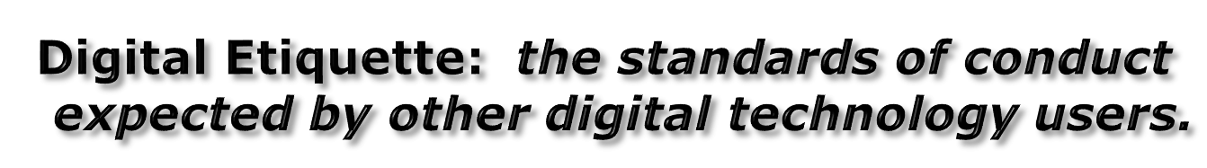
Digital Access: full electronic participation in society.
Digital Law: the legal rights and restrictions governing technology use.

Slide 6
Digital Communication: electronic exchange of information.
Digital Literacy: the capability to use digital technology and knowing when and how to use it.
Digital Commerce: the buying and selling of goods online.

Slide 7
Digital Rights and Responsibilities: the privileges and freedoms extended to all digital technology users, and the behavioral expectations that come with them
Digital Security (self-protection): the precautions that all technology users must take to guarantee their personal safety and the security of their network.
Digital Health and Welfare: the elements of physical and psychological well-being related to digital technology use.

Slide 8


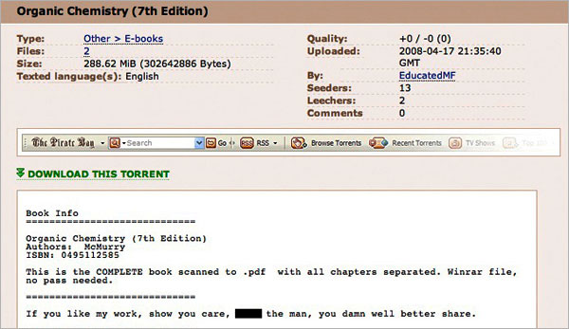

Digital Law: the legal rights and restrictions governing technology use.
A MySpace Photo May Cost a
Student a Teaching Certificate
First It Was Song Downloads. Now It’s Organic Chemistry.

Slide 9

Digital Health and Welfare: the elements of physical and psychological well-being related to digital technology use.
Texting, Surfing, Studying?
“The literature looking at media and its impact on attentional skills is just in its infancy,” said Renee Hobbs, a
professor of mass media and communications at Temple University. Another expert, Dr. Dimitri Christakis, a professor of pediatrics at the University of Washington who is a leading researcher on children and the media, agreed. “The pace of science has not kept up with technology,”.
PBS – Frontline
-Roughly 50 percent of South Koreans play games regularly, and 75 percent of gamers prefer online games.
-Questions of Internet Addiction

Slide 10





Digital Security (self-protection): the precautions that all technology users must take to guarantee their personal safety and the security of their network.

Slide 11
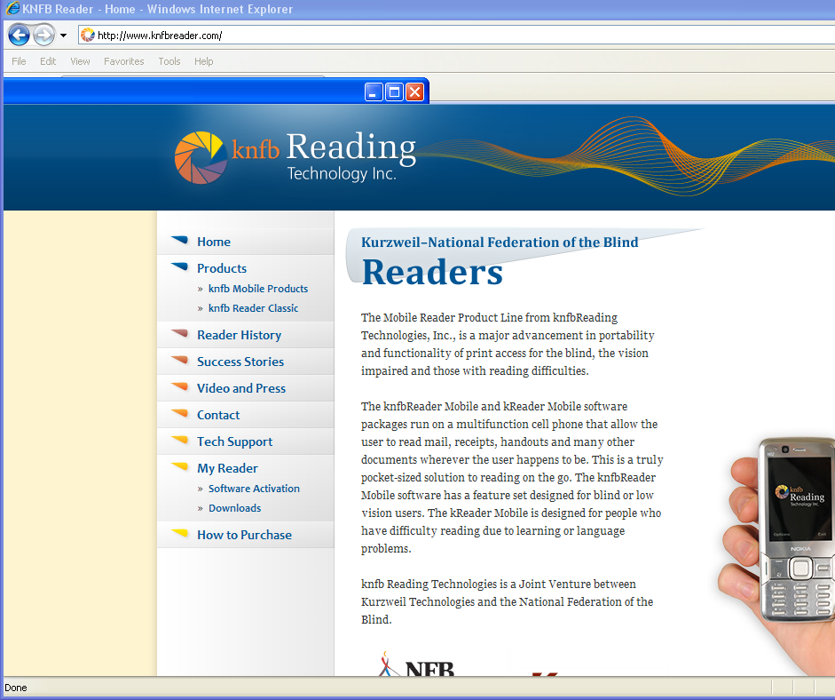
Digital Access: full electronic participation in society.

Slide 12
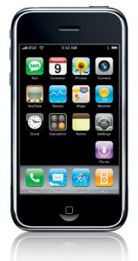


Digital Communication: electronic exchange of information.
Face-to-Face Socializing Starts With a Mobile Post
Twitter and Facebook ask users to
answer the question: What are you
doing right now?
But for many urbanites in their 20s
and 30s, two other questions are
just as important: Where are you,
and can I come join you?

Slide 13

Digital Etiquette: the standards of conduct expected by other digital technology users.
ALL CAPS emails lead to woman's firing
OK, I can't actually make that text red due to the publishing system I'm on, but it would certainly be annoying, wouldn't it?
And if you worked for New Zealand's ProCare Health, it could even get you fired.

Slide 14
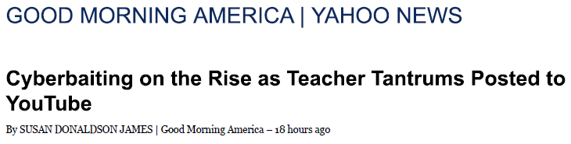


Digital Rights and Responsibilities: the privileges and freedoms extended to all digital technology users, and the behavioral expectations that come with them

Slide 15


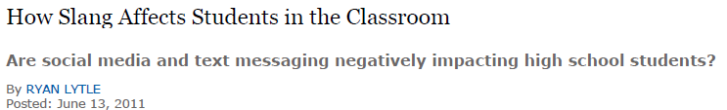
Digital Literacy: the capability to use digital technology and knowing when and how to use it.

Slide 16
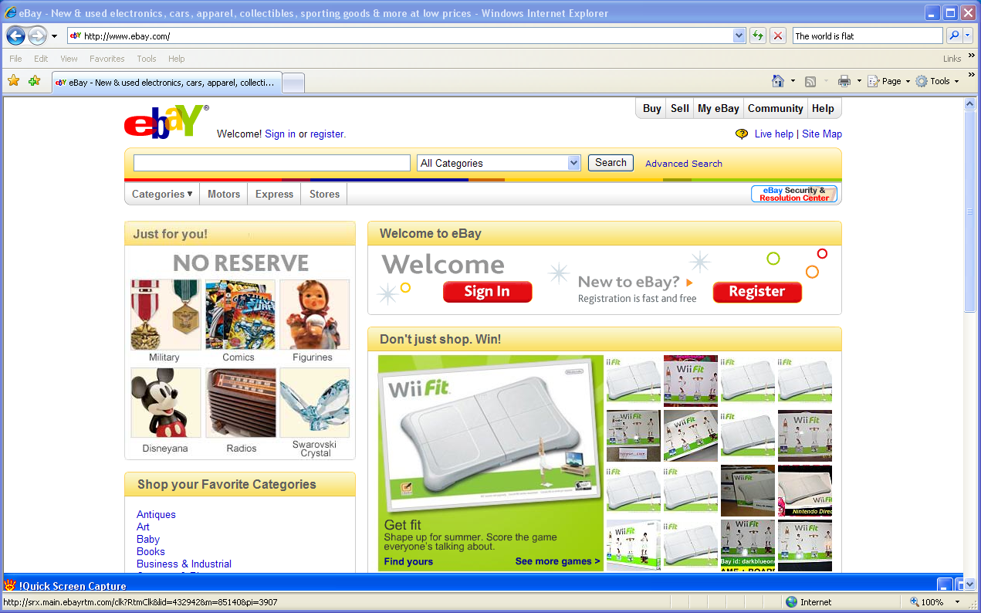
Digital Commerce: the buying and selling of goods online.
Losing Out After Winning an Online Auction
“There’s a lot of ways to lose money with online auctions,” said Sally Greenberg, executive director of the National Consumers League. With all the possible ways of losing money, it’s no wonder that online auction fraud was ranked as the 13th biggest concern of consumers in the 2008 Consumer Sentinel, which is compiled by the Federal Trade Commission

Slide 17
Just Because We Can – Should We?
Should our “Digital Citizenship” be any different than our country citizenship?
Let’s take a look at some ideas/issues.

Slide 18
Bullying/CyberBullying
Similarities
Differences
Both deal with one person taking attacking another psychologically.
Students can deal with both through intervention.
Both can continue after school as well.
Technology can make people feel anonymous.
Technology can involve a larger number of people.
Regular bullying can have a physical aspect as well.

Slide 19
Stealing
Candy Bar
Downloading songs
Laws against shoplifting
Causes loss of revenue store
We typically teach our children/students it is not appropriate.
Laws against downloading – but many opportunities.
Can decrease revenue for companies.
We don’t always state to children/students that it is wrong.

Slide 20
Driving Issues
Drinking
Texting
Alcohol Addiction
Physical Issues
Loss of Attention
Can Lead to Accidents
Laws Against Doing
Technology Addiction
Can Have Physical Issues
Loss of Attention
Can Lead to Accidents
New Laws Being Passed

Slide 21
What we will be doing…
For the next few minutes begin thinking about how you can integrate these nine elements into your curriculum and classroom for your college.

Slide 22
Exercise
Register blog (use blogger.com or wordpress.com or any other free blogging website)
What is digital citizenship? (in-text citation required)
What is digital media?
What is the difference between bullying and cyberbullying
Give brief summery of a case study about online identity theft.
What steps could you take to protect your privacy online?
Summarize the nine elements of digital citizenship
Upload your answers (500 words maximum) on your blog.

